Slide 1
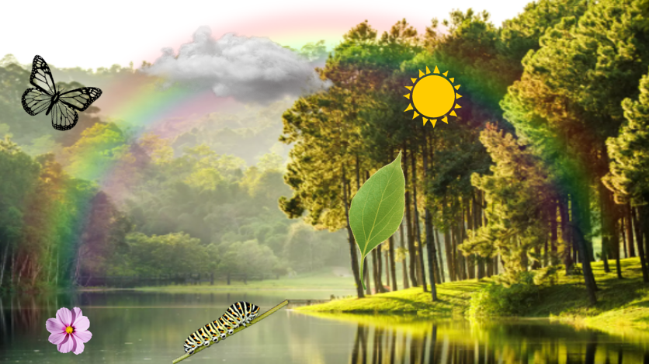

Slide 2
Write six nature words from the previous image. / Escribe seis palabras de la naturaleza, de la imagen anterior.
_________________ __________________ __________________
_________________ __________________ __________________
Write in the notebook the twelve months (including the missing one) and color them according to their season. / Escribe en tu libreta los doce meses (incluyendo el que falta) y coloréalos de acuerdo a su estación.
JANUARY – FEBRUARY – MARCH – APRIL – MAY – JUNE
AUGUST – SEPTEMBER – OCTOBER – NOVEMBER – DECEMBER
Spring (pink) / summer (green) / fall (orange) / winter (blue)

Slide 3
Write with letter the times / Escribe con letra las horas.
What time is it? 9:15 _____________________________
What time is it? 11:00 _____________________________
What time is it? 10:30 _____________________________
What time is it? 4:45 _____________________________
What are the dates of these events in the history of Mexico? / ¿Cuáles son las fechas de estos eventos de la historia de México
Independence Day _____________________________
Battle of Puebla _____________________________
Constitution Day _____________________________
Revolution Day _____________________________

Slide 5
What actions are portrayed in the previous image? Write them in your notebook. / ¿Qué acciones se representan en la imagen anterior? Sin ver, escríbelas en tu libreta.
__________________________________________________
__________________________________________________
__________________________________________________
Read the words, and write the incorrect ones in the correct way. / Lee las palabras y escribe SÓLO las incorrectas pero de manera correcta en tu libreta.
shool
houce
teahcer
caterpilar
leaf
English
reinbow
February
wekend
showwer
playgound
teeth
ssnake
enjoy
studen’t

