Slide 1
Correct the spelling of the words. One word is correct.
Englihs – teahcher – shool – boook – hanimals
numvers – Mexico – houce
____________________________________
____________________________________
____________________________________

Slide 2
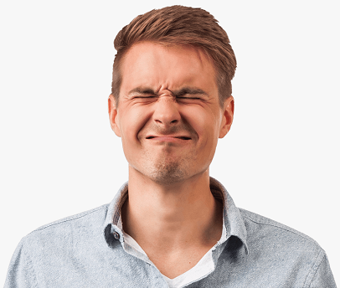
Check the correct words. Mark the incorrect ones.
shoulder
mouth
hair
nose
ear
chin
forehead
neck

Slide 3
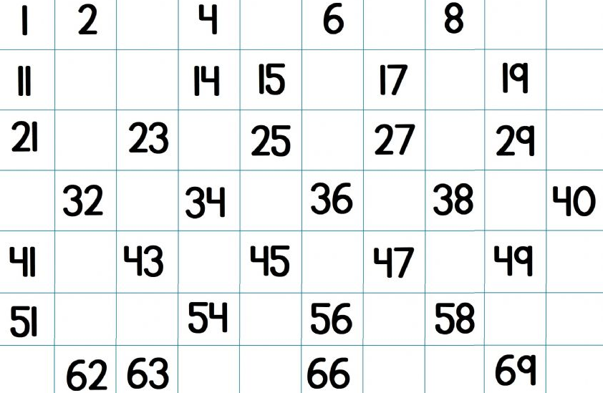
Write IN THE NOTEBOOK the missing numbers.
Then, record an audio saying ONLY the missing numbers.
Escribe los números que faltan. Luego, graba un audio en el que digas SÓLO los números que faltan.

Slide 4
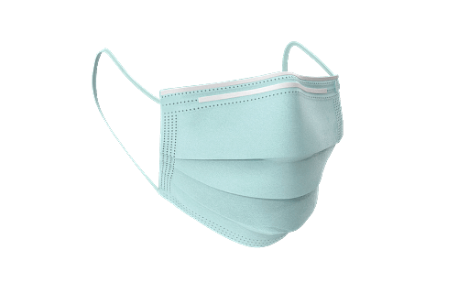
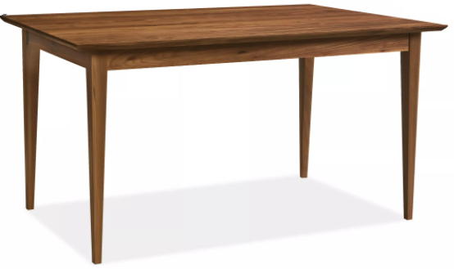
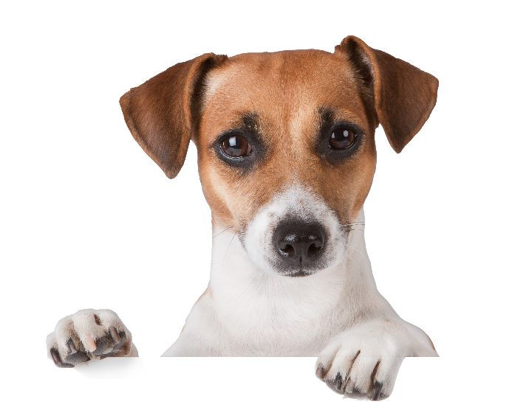
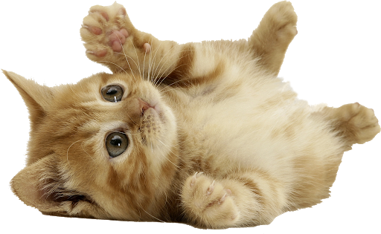

Slide 5
Write UNDER, IN, ON, according to the previous image.
Escribe UNDER, IN, ON, de acuerdo con la imagen anterior.
The facemask is _______the table.
The dog is _______ the box.
The cat is _______ the table.
The flower is _______ the box.
The book is _______ the table.

